Slide 1


Digital Twin System for Automotive Safety with Integration of a Safety Controller
Pruthvi Krishnamurthy
MSc Automotive Technology, MDSE
Notes:
Good Morning
Thanks for being here for my presentation
My research topic is
It combines digital and automotive safety and testing

Slide 2
Table of Contents
Introduction
Problem Statement
Research Question
Methodology
Implementation
Results and Discussion
Conclusion
Future Works
Notes:
Before we dive into main content
Let me give an overview of the sections that we’ll be covering

Slide 3

How confident are you about your car’s reliability ?
Why?
Extensive Physical Tests as per Standards and Regulation
Introduction
Problem Statement
Research Question
Methodology
Implementation
Results and Discussion
Conclusion
Future Works
Notes:
Pretty confident right ?

Slide 4
Testing for Advanced Systems
For features like Advanced Driver-Assistance System (ADAS) requires more special tests:
Automatic Emergency Braking
Lane Assist
Adaptive Cruise Control
Automatic Parking
We need to create suitable scenarios
Introduction
Problem Statement
Research Question
Methodology
Implementation
Results and Discussion
Conclusion
Future Works
Notes:
Explain ADAS
Requires special setups and scenarios

Slide 5
Drawbacks of Modern Testing
Expensive (Special setups)
Time consuming
Resource intensive
Tedious for multiple iterations
Requires controlled environment
Introduction
Problem Statement
Research Question
Methodology
Implementation
Results and Discussion
Conclusion
Future Works

Slide 6
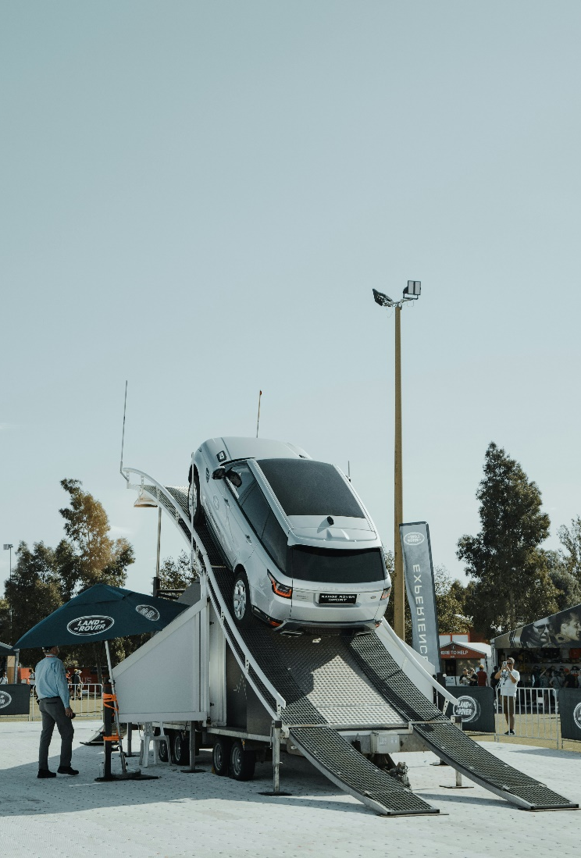
Why this Project ?
How Automotive Industry can improve testing methods
Actual Human -> Crash Dummy -> Digital Twin
Hazard Analysis & Risk Assessment scenarios
Using virtual sensors
Minimize Testing & Verification costs
Introduction
Problem Statement
Research Question
Methodology
Implementation
Results and Discussion
Conclusion
Future Works
Notes:
physical testing consume more time, resources, and money
20 to 30 percent of development cost is spent on testing and validation and the shift towards virtualization reduces the cost and time.
The Digital Twin System can be a solution to this by stimulating these scenarios in a reliable virtual environment before physical testing to accelerate the development process

Slide 7
Research Questions
How a Digital Twin System can be integrated with a Safety Controller?
1. How an Automotive System can be designed with Safety mechanisms?
2. How can virtual sensors be used instead of physical sensors?
3. How a Safety Controller can be integrated into the Hardware-in-loop (HIL) setup?
4. How the Digital Twin System’s performance can be optimized?
Introduction
Problem Statement
Research Question
Methodology
Implementation
Results and Discussion
Conclusion
Future Works

Slide 8
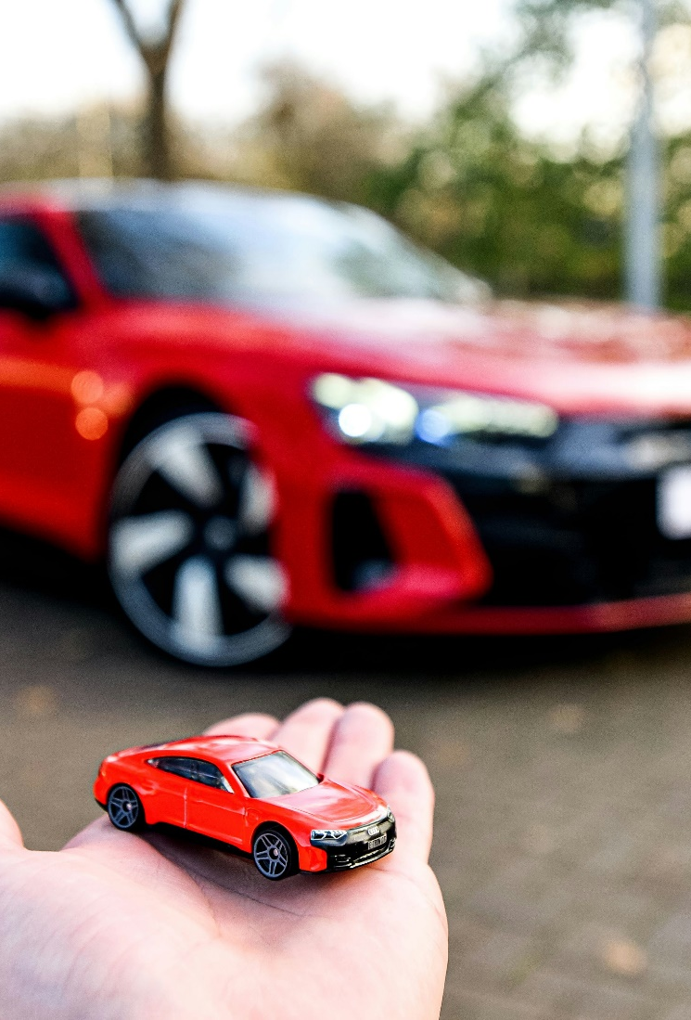
Digital Twin
Virtual replica of Physical Twin
Digital Twin System
Virtual + Physical Twin
Communication
Data
Introduction
Problem Statement
Research Question
Methodology
Implementation
Results and Discussion
Conclusion
Future Works

Slide 9


Digital Twin System (DTS)
Service System
Digital Twin Data
Virtual Entity
Physical Entity
[Ref:Dynamic analysis of digital twin system based on five-dimensional model]
Physical entity, Virtual entity, Service system and Digital twin Data
Introduction
Problem Statement
Research Question
Methodology
Implementation
Results and Discussion
Conclusion
Future Works
Notes:
physical entity or the physical twin, the virtual entity or the digital twin, the service system, the digital twin data, and the connection.
the digital twin system is a dynamic system
The service system is an operational platform with input and output functions. Its workflow is: read data from external objects- form a database- make operational decisions- modify the database.

Slide 10
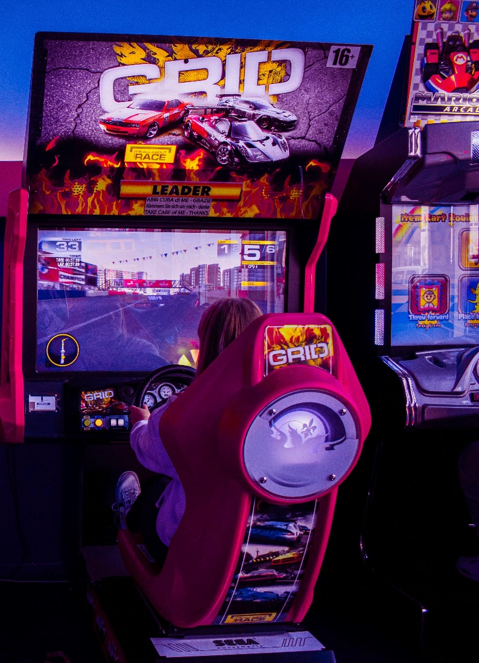
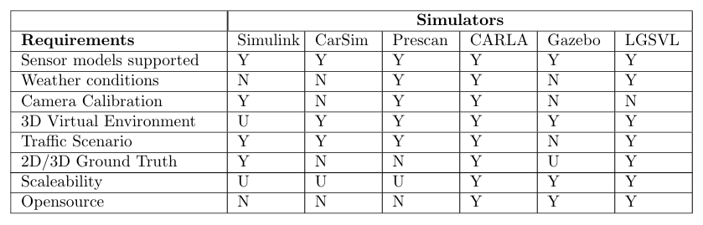
Virtual Twin
Comparison of Simulators
Y: Yes, N: No, U: Unknown
[Ref:A survey on simulators for testing self-driving cars]
Why CAR Learning to Act (CARLA) ?
Introduction
Problem Statement
Research Question
Methodology
Implementation
Results and Discussion
Conclusion
Future Works
Notes:
CarSim – Cars
Prescan – 3D environments
Gazebo – Robots
LGSVL – Unity Game Engine
CARLA – Unreal Engine
Requirement - the simulator should be capable of simulating autonomous vehicles, and support scenario based testing, and compatible with ROS environment.

Slide 11
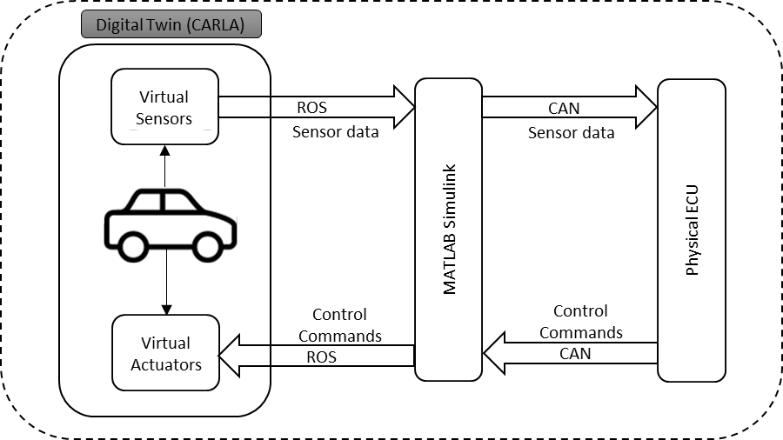


Digital Twin System (DTS) Communication
Physical Twin (Scaled Race Car)
Digital Twin (CARLA)
Digital Twin (CARLA)
Virtual Sensors
Physical Sensors
ROS
CAN
Sensor data
Sensor data
MATLAB Simulink
Physical ECU
Control Commands
Control Commands
Virtual Actuators
Physical Actuators
ROS
CAN
Introduction
Problem Statement
Research Question
Methodology
Implementation
Results and Discussion
Conclusion
Future Works
Notes:
Explain ROS and CAN as
communication protocol
ROS – Robotic applications
CAN – ECU communication

Slide 12
Block Diagram for DTS
Data from DTS
Perform Safety Analysis
Concept System Design
Introduction
Problem Statement
Research Question
Methodology
Implementation
Results and Discussion
Conclusion
Future Works

Slide 13
V-Model Framework using Digital Twin System
System Concept Development
Data analysis, System Verification & Improvement
System
Requirements
Integrate with Physical Twin & Test (VIL)
Integrate with ECU & Test (HIL)
System
Design
Perform Safety
Analysis & Improve
Integrate with Digital Twin & Test (MIL)
System
Development & Implementation
Introduction
Problem Statement
Research Question
Methodology
Implementation
Results and Discussion
Conclusion
Future Works
Notes:
V-model provides a structured framework for automotive development lifecycle
Advantage : Early verification avoids defects in later stages and saves cost

Slide 14
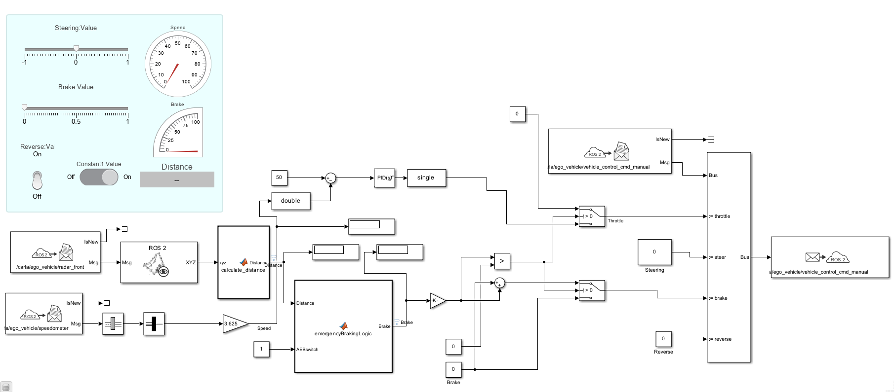
Simulink Model for Automatic Emergency Braking (AEB)
Dashboard
Control commands to CARLA
AEB Logic
Sensor data from CARLA
Introduction
Problem Statement
Research Question
Methodology
Implementation
Results and Discussion
Conclusion
Future Works

Slide 15
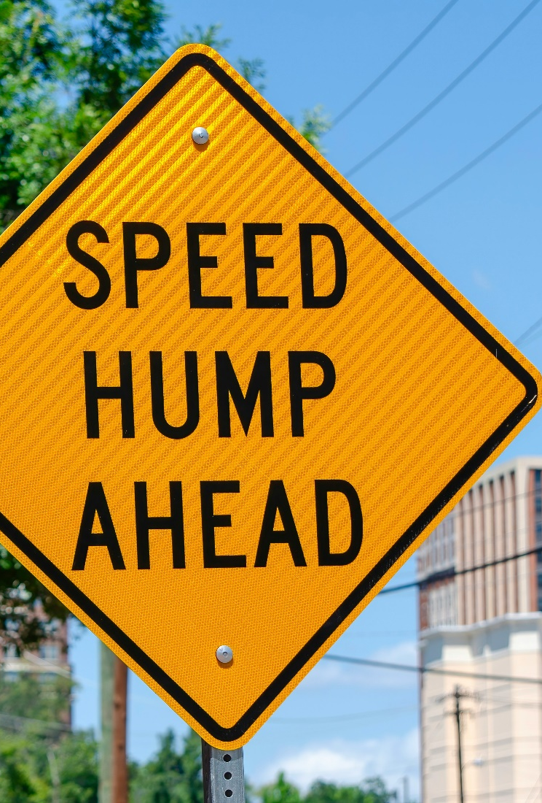
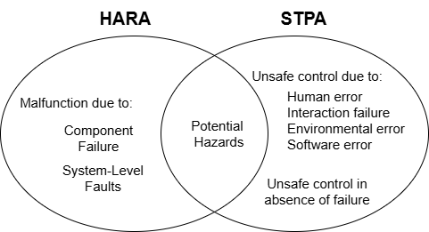
Safety Analysis
System-Theoretic Process Analysis (STPA)
Why STPA ?
[Ref: New approaches for automated vehicles certification: Part I - current and upcoming methods for safety assessment]
Introduction
Problem Statement
Research Question
Methodology
Implementation
Results and Discussion
Conclusion
Future Works
Notes:
STPA is a relatively new hazard analysis technique.
In addition to component failures, STPA assumes that accidents can also be caused by unsafe interactions of system components, none of which may have failed.
Hazards that were previously only found in operations can be identified early in development and both intended and unintended functionality are handled.

Slide 16
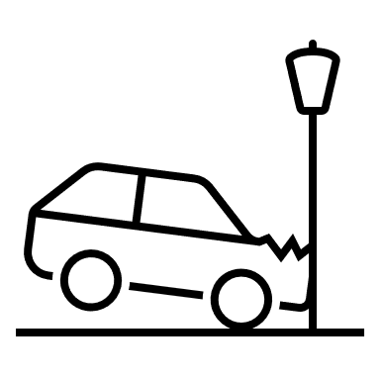


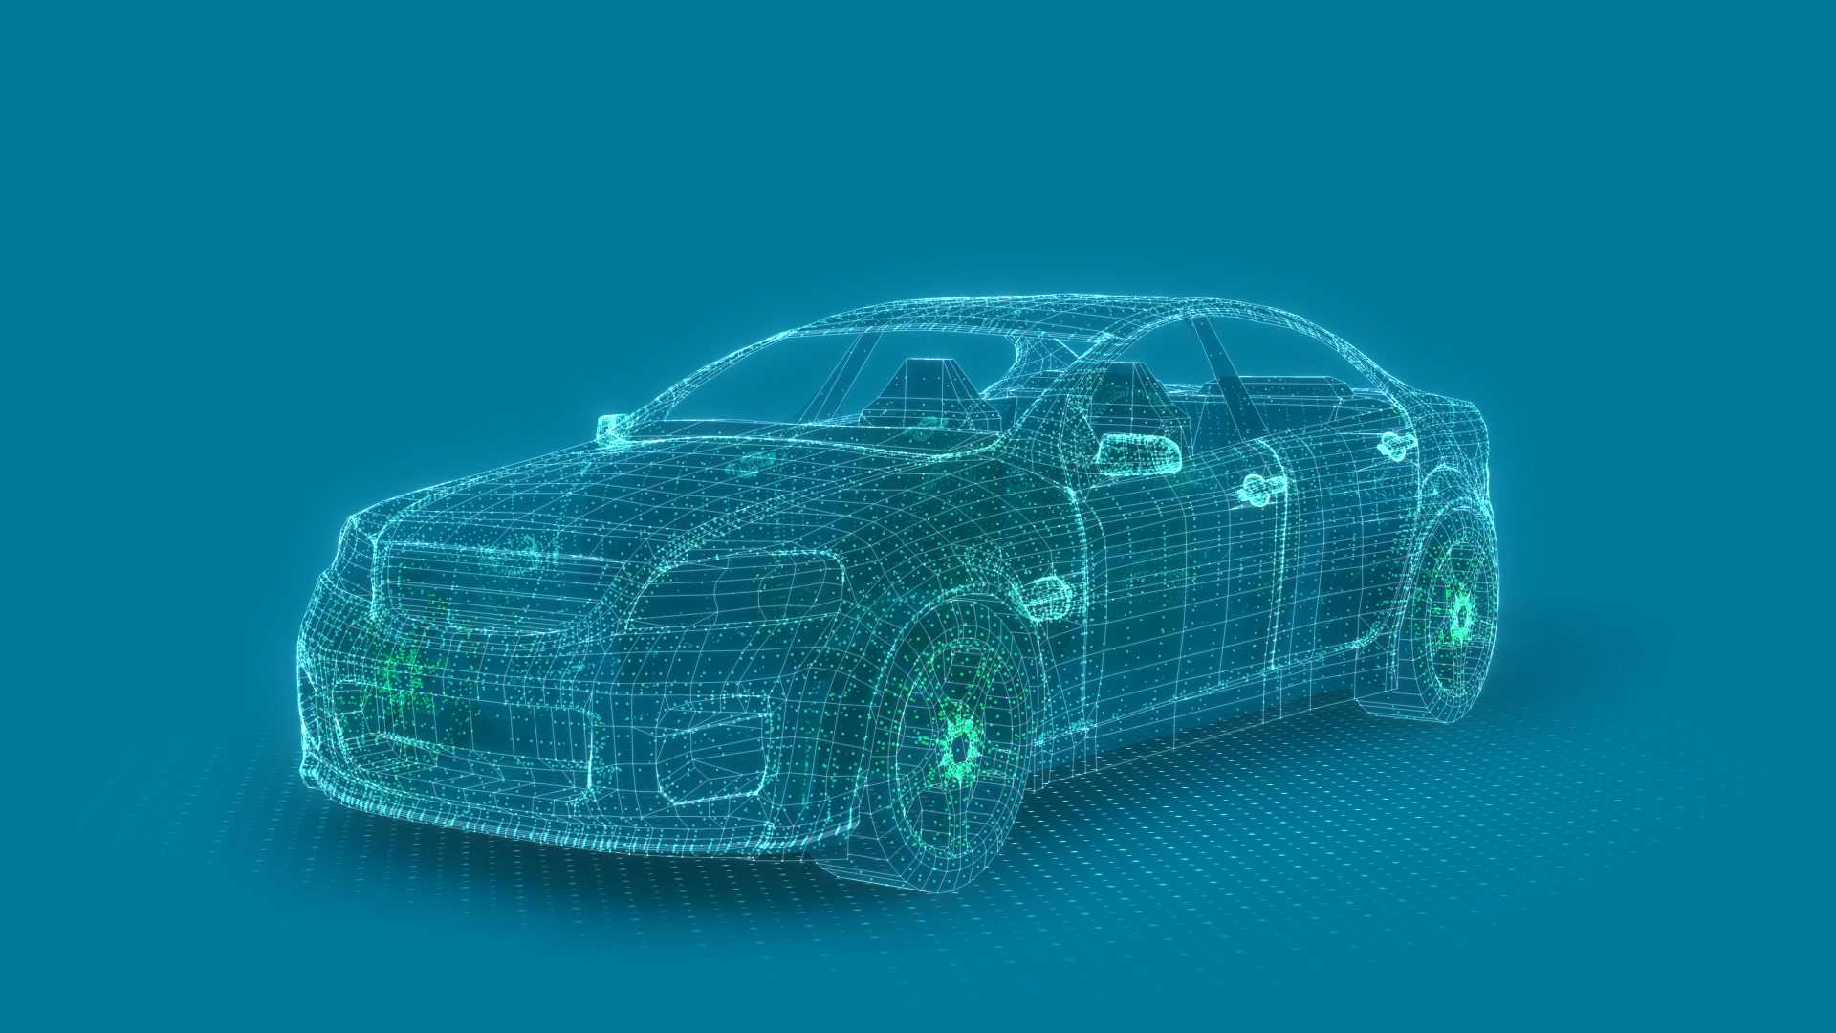
System-Theoretic Process Analysis (STPA)
Identify Unsafe Control Actions
Identify Loss Scenarios
Define Safety Mechanism
Safety Mechanisms for AEB
Communication:
Redundancy
Time out monitoring
Sensors:
Valid Range
Correlation
Control Actions:
Supervision and Correlation
[Ref: N. G. Leveson and J. P. Thomas, “STPA handbook”]
Introduction
Problem Statement
Research Question
Methodology
Implementation
Results and Discussion
Conclusion
Future Works
Notes:
STPA is important due to loss scenarios

Slide 17
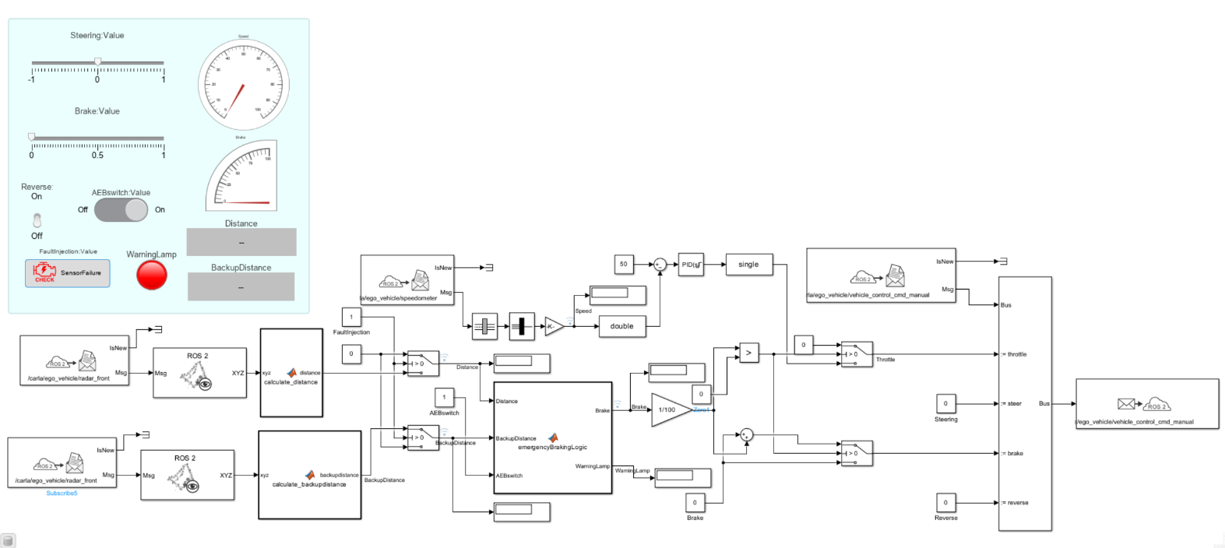
Simulink Model for AEB with Safety Mechanisms
Fault Injection & Warning Lamp
Backup Sensor Communication
Introduction
Problem Statement
Research Question
Methodology
Implementation
Results and Discussion
Conclusion
Future Works
Notes:
The safety mechanisms are implemented in the model, A redundancy or back up if one sensor fails to send data.
A fault injection to create this loss scenario and a warning signal is sent if the system uses backup sensor.

Slide 18
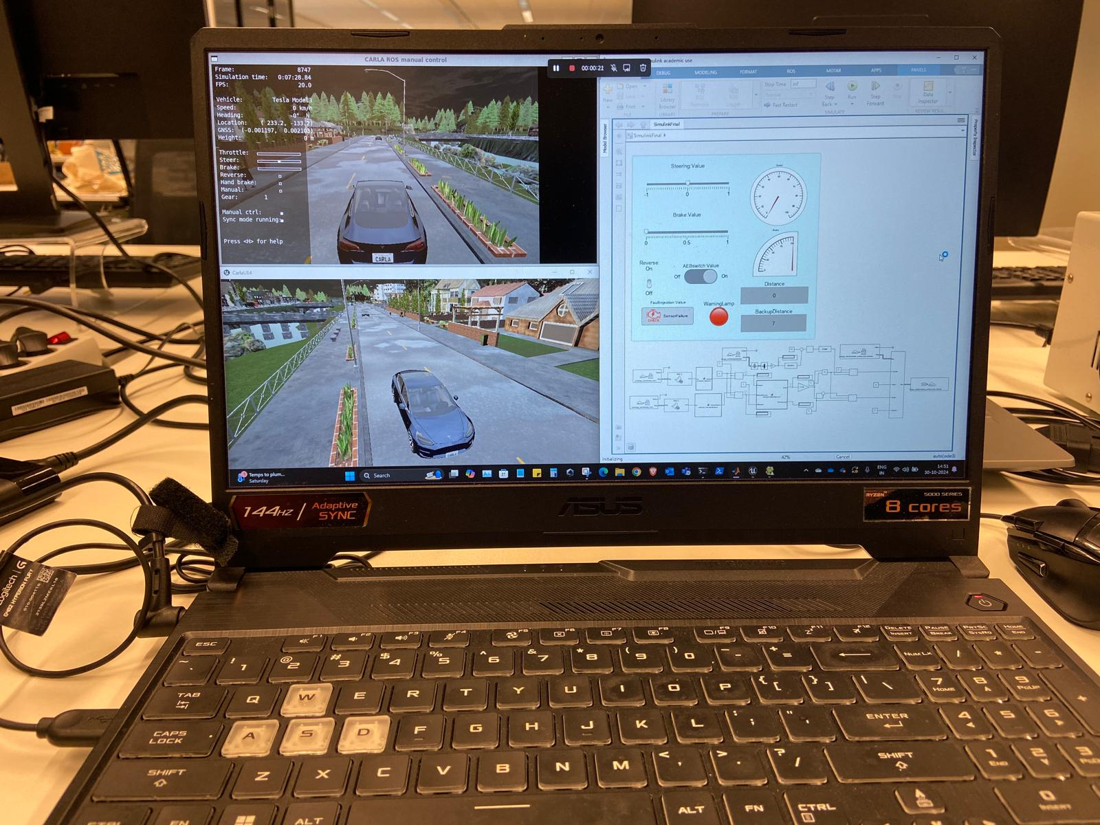
Model-in-the-Loop (MIL) Setup
Model-in-the-Loop test Setup
Introduction
Problem Statement
Research Question
Methodology
Implementation
Results and Discussion
Conclusion
Future Works
Notes:
Explain What is model in the loop

Slide 19
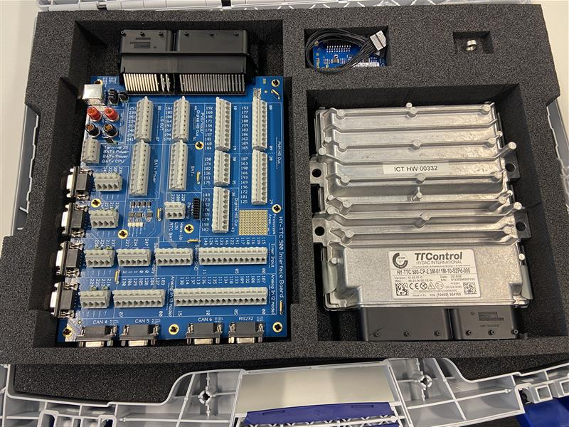
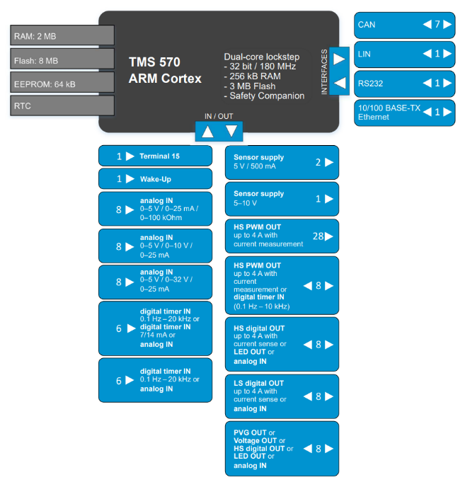
Safety Controller HY-TTC 580
Introduction
Problem Statement
Research Question
Methodology
Implementation
Results and Discussion
Conclusion
Future Works
Notes:
rough operating conditions
ASIL C
high-end safety-control units

Slide 20
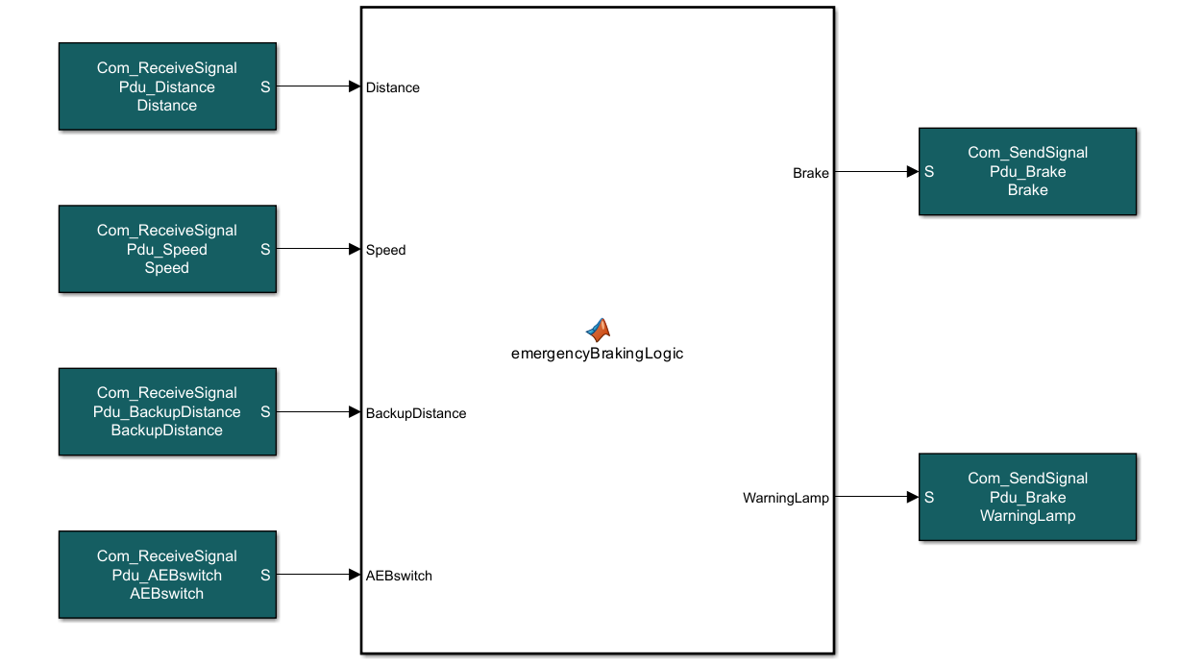



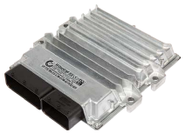
Flashing the ECU using MOTAR
Simulink Model
MOTAR Toolbox
Target ECU
Code Generation
Introduction
Problem Statement
Research Question
Methodology
Implementation
Results and Discussion
Conclusion
Future Works
Notes:
configuring the simulink model into the MOTAR toolbox and the motar toolbox converts it into C code and generates a hex file which is then flashed into the target hardware.
This is how the AEB model is configured in the motar toolbox, the sensor inputs and control outputs are configured as per the CAN communication configuration defined according to the motar tool box.

Slide 21
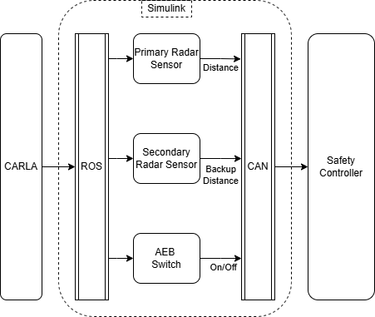
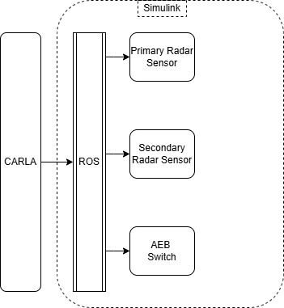
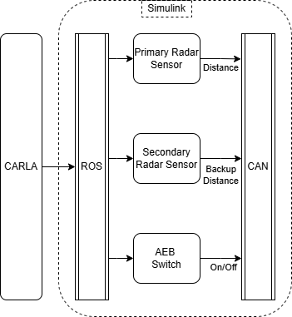
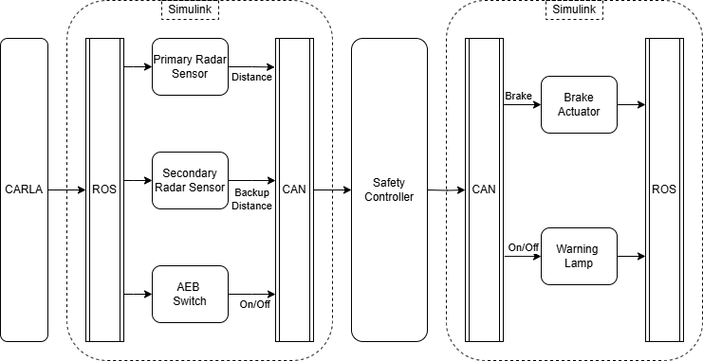
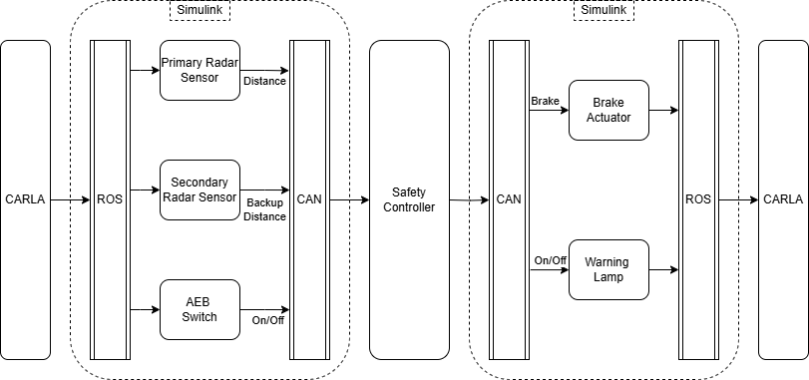
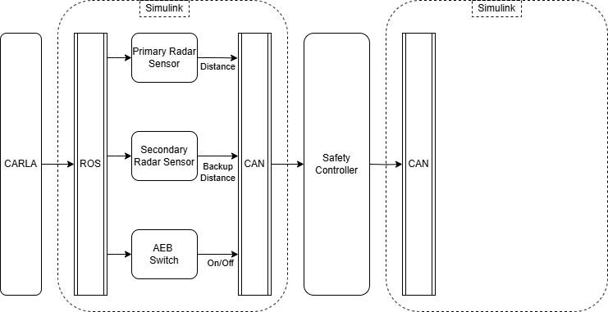
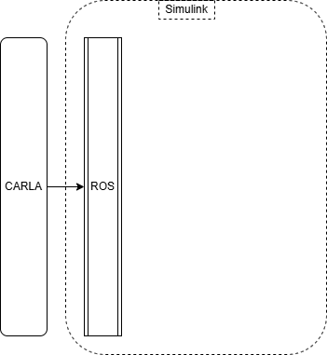
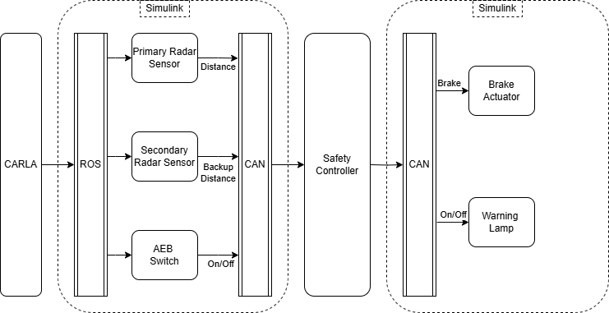

HIL Setup Communication
Introduction
Problem Statement
Research Question
Methodology
Implementation
Results and Discussion
Conclusion
Future Works
Notes:
Now lets see how the total HIL setup communicates with each other.

Slide 22
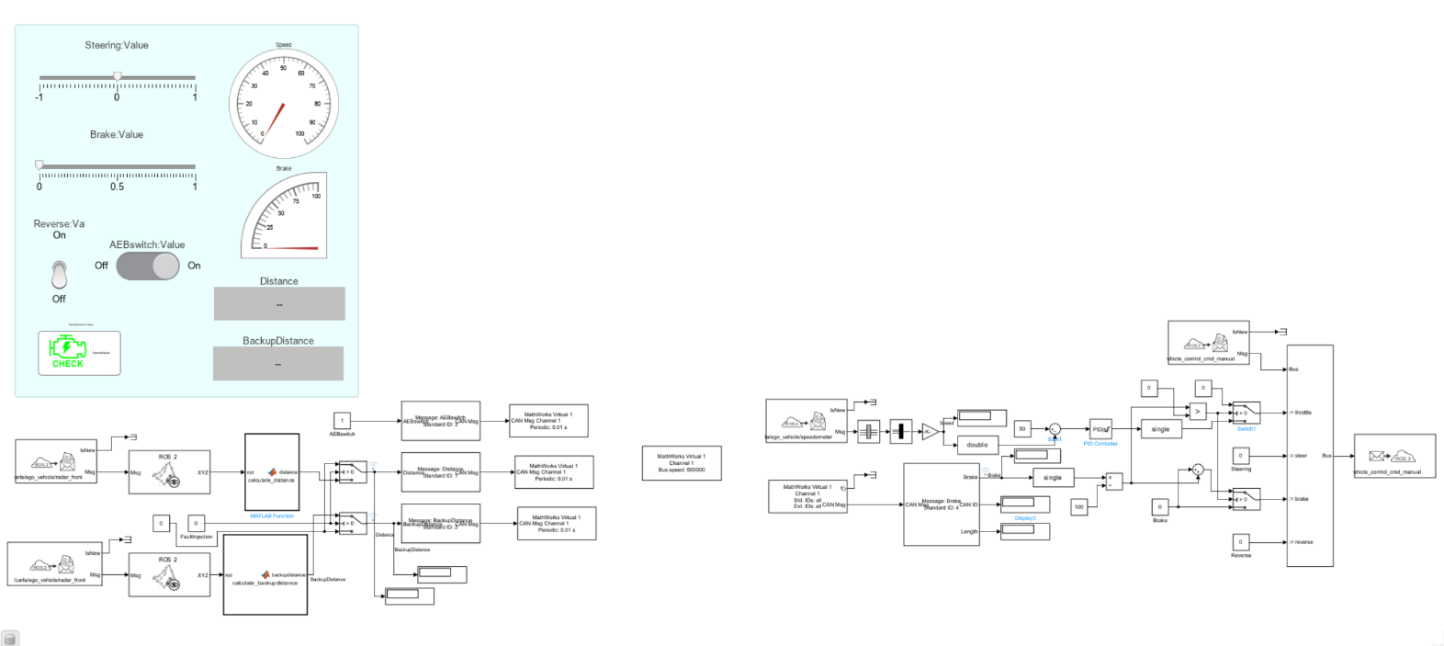
Simulink Model for CAN Communication
CAN Receive
CAN Transmit
CAN Configuration
Introduction
Problem Statement
Research Question
Methodology
Implementation
Results and Discussion
Conclusion
Future Works
Notes:
This is the CAN communication model that acts as communication bridge between Carla and the ECU.
These are the sensor inputs from carla sent to the ECU.
This is the CAN configuration settings in simulink.
These are the control outputs received from the ECU and sent back to carla.

Slide 23
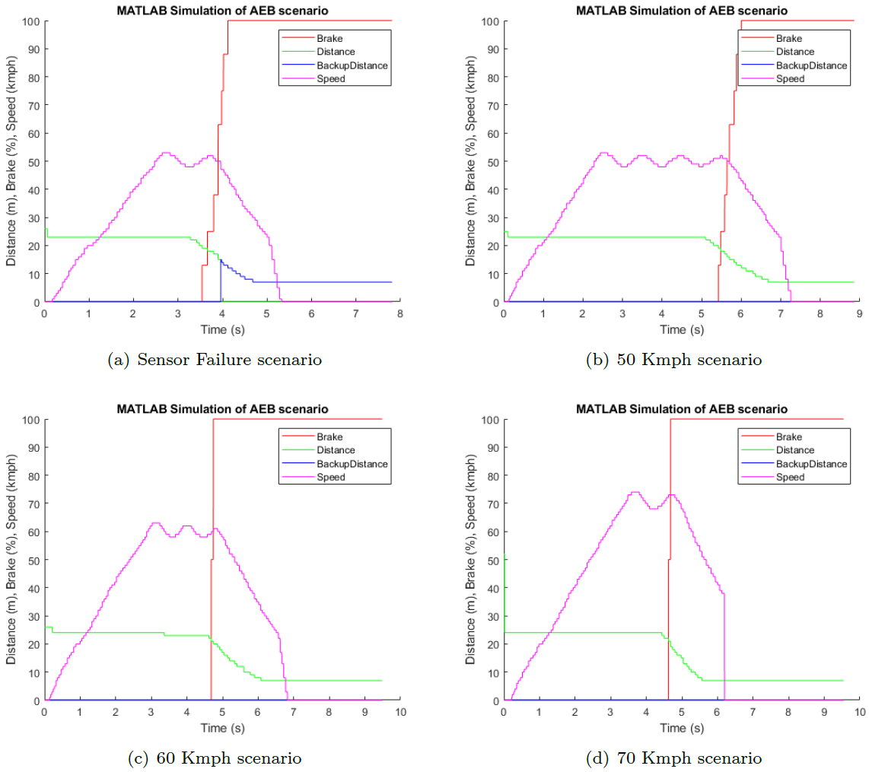
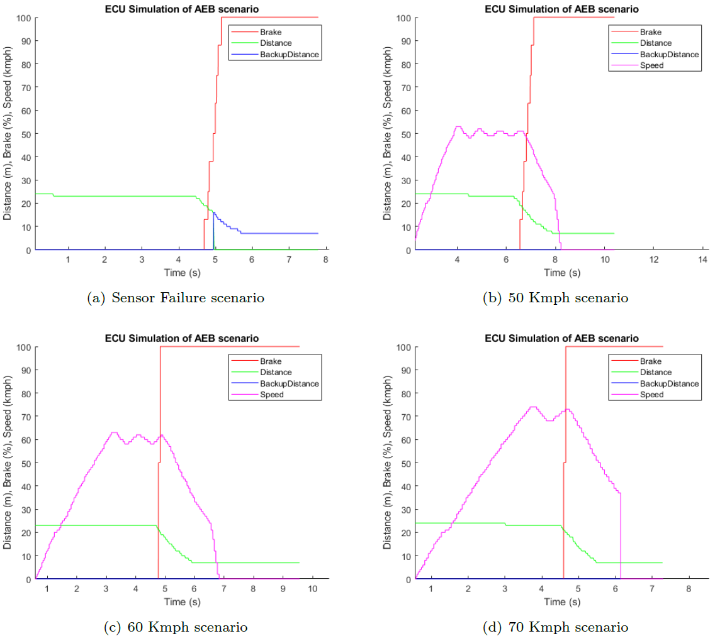
Data analysis MIL vs HIL
Collision
Collision
Introduction
Problem Statement
Research Question
Methodology
Implementation
Results and Discussion
Conclusion
Future Works
Notes:
Higher speeds
Steeper brake curve
MIL and HIL results are similar
We can infer that as speed increases the obstacle is reached quicker and the braking becomes harsh leading to steeper braking curve.

Slide 24
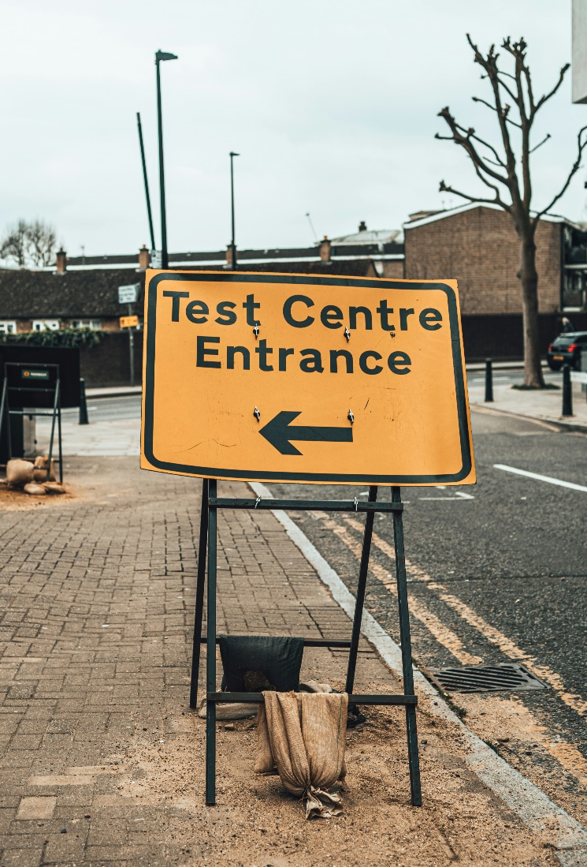
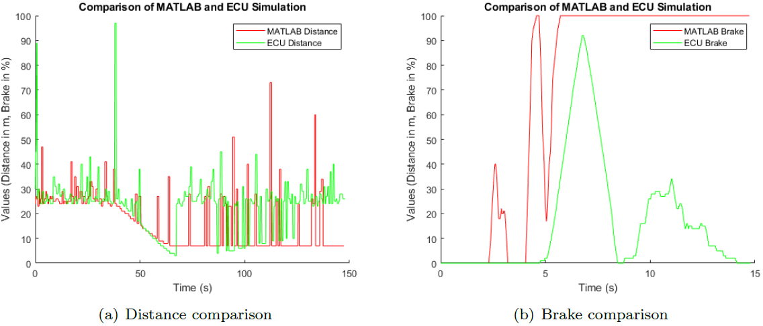
Results & Discussion
Findings
Limitations
Computational Limitations
Sensor Limitations
Challenges
Introduction
Problem Statement
Research Question
Methodology
Implementation
Results and Discussion
Conclusion
Future Works
Notes:
In Findings
virtual tests before physical tests
Reduce Testing costs
Accelerate Development Process
moving averages
by adding a delay in the Simulink model
Challenges – Thorough MIL and HIL tests for each system

Slide 25

Conclusion
How a Digital Twin System can be integrated with a Safety Controller?
The Digital Twin setup interacts with Safety Controller via ROS and CAN and functions as intended.
1. How an Automotive System can be designed with Safety mechanisms?
Safety mechanisms were derived through STPA and implemented in the AEB system.
2. How can virtual sensors be used instead of physical sensors?
Virtual sensors from CARLA is used in the HIL simulation through DTS instead of physical sensors.
3. How a Safety Controller can be integrated into the HIL setup?
Safety Controller is integrated into the HIL setup by flashing the AEB model using MOTAR toolbox.
4. How the Digital Twin System’s performance can be optimized?
Data collected during the HIL testing can be used to optimize both the performance of Digital Twin and also the AEB system.
Introduction
Problem Statement
Research Question
Methodology
Implementation
Results and Discussion
Conclusion
Future Works
Notes:
How it reduces the cost
Impacts on Industry and R&D
How digital twin improves testing
Faster test and development of algorithms

Slide 26
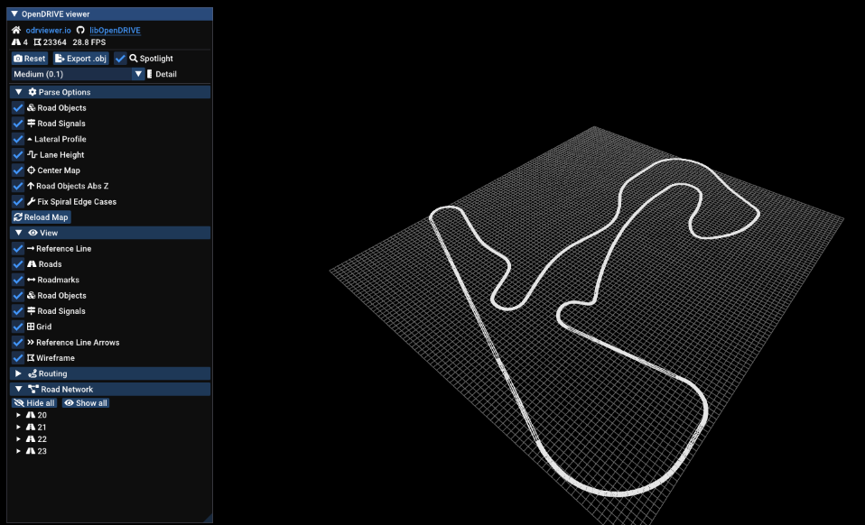
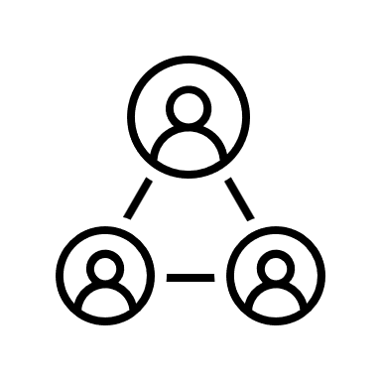


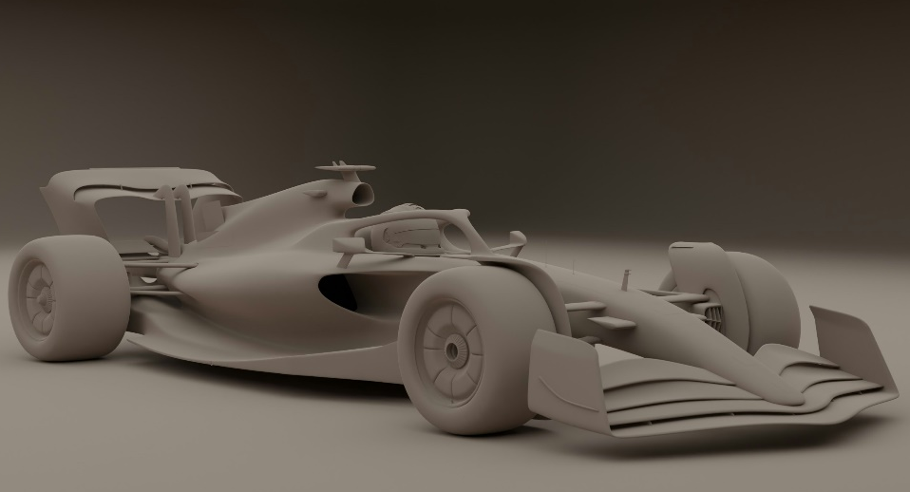
Future Work
Complete Physical Twin
Model custom Maps
Model custom Cars
Custom Scenarios
Introduction
Problem Statement
Research Question
Methodology
Implementation
Results and Discussion
Conclusion
Future Works
Notes:
Custom maps is currently a experimental feature in Carla’s Digital Twin update

Slide 27
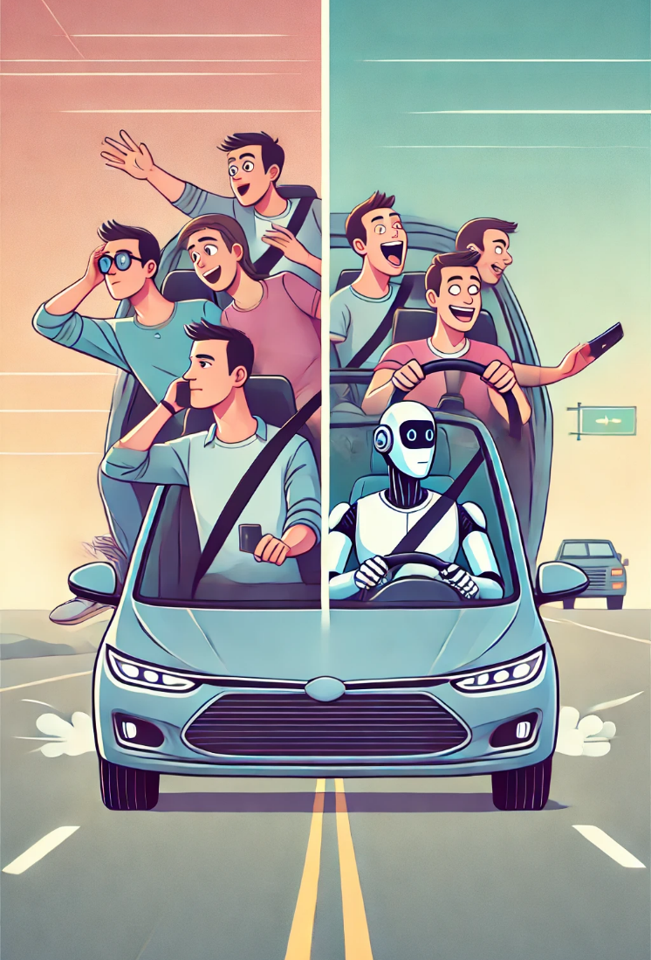
Thank you!
I would love to hear from you!
Questions?

